Slide 1
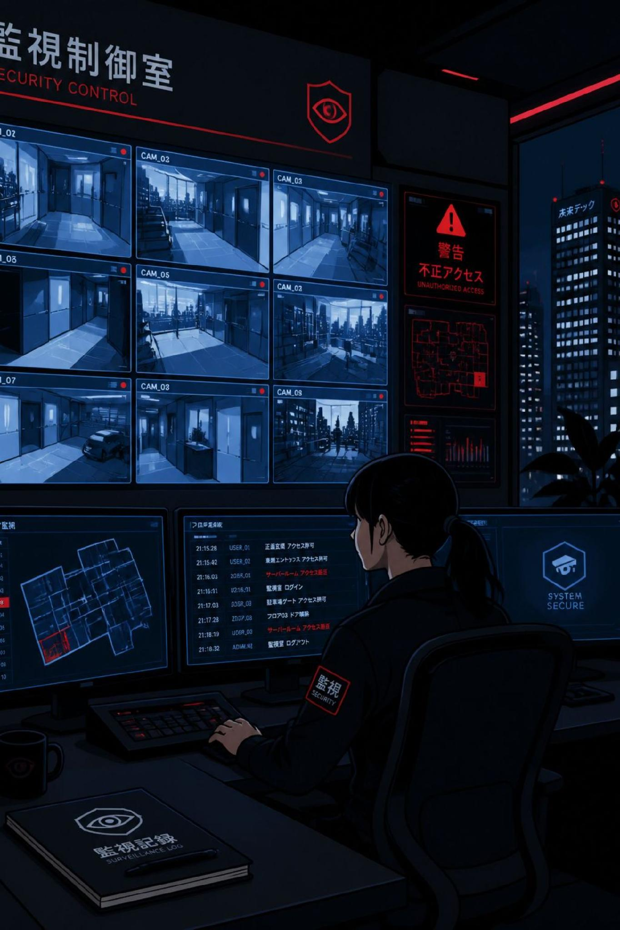
Zyvora
Surveillance System by Eonovate
AI-Powered Multi-Branch Monitoring & Compliance
See Everything. Miss Nothing.

Slide 2
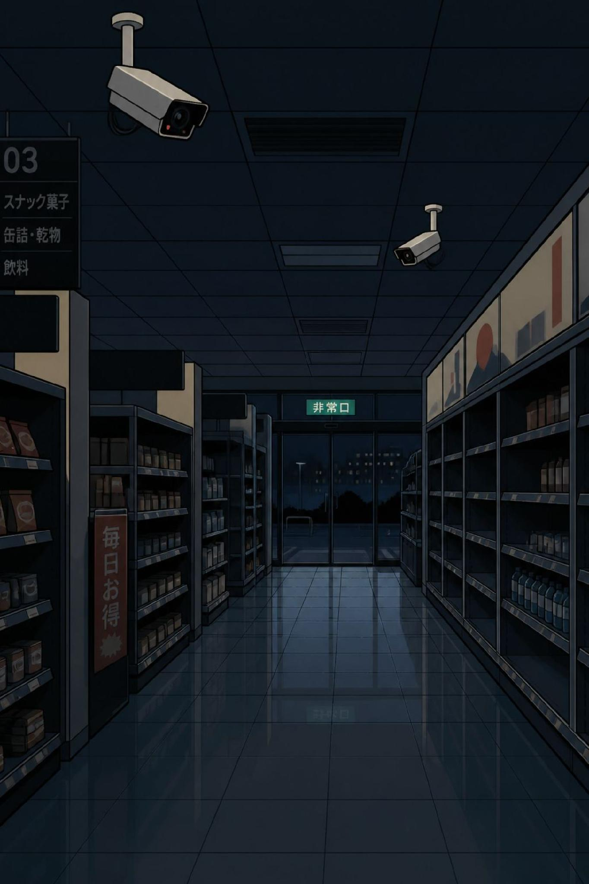


The Challenge Every Franchise Owner Faces
No Physical Oversight
You cannot be everywhere at once. Staff violations go unnoticed across branches.
Undetected Violations
Hygiene lapses, phone use, idle counters — all invisible without constant monitoring.
Slow, Biased Reporting
Manual reports are delayed, incomplete, and unreliable.
Brand Risk
One bad branch can damage your entire franchise's reputation.

Slide 3
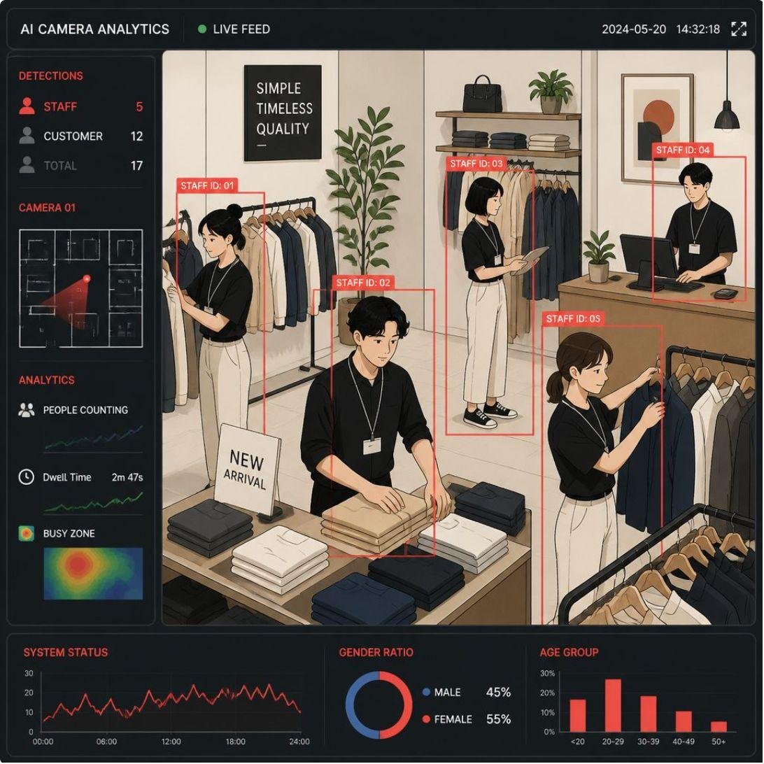

OUR SOLUTION
Intelligent Monitoring, Zero Manual Effort
Zyvora uses AI-powered cameras to automatically detect, log, and alert on staff behavior violations across all your branches — 24/7, with no human monitoring required.
From hygiene breaches to security lapses, every incident is captured, timestamped, and delivered directly to you.
Real-time alerts reach you in under 5 seconds.

Slide 4






Key Features
Live AI Detection
Instant WhatsApp Alerts
YOLO-based real-time analysis of every camera feed, continuously.
Violation reports sent to owners immediately with photo evidence.
Face Recognition
Multi-Branch Dashboard
Automatically identifies which employee committed each violation.
Monitor all shops from a single screen with unified controls.
Violation Reports
Customer Live View
Filter by date, branch, camera, severity — export to CSV instantly.
Customers watch order processing live via your mobile app.

Slide 5

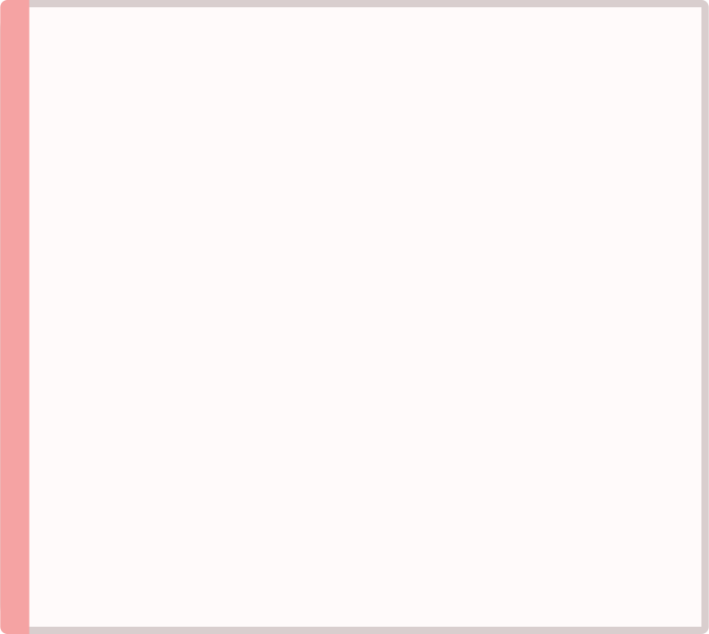
What We Detect
Counter Zone
Gate & Security
Processing Zone
Packaging & Cleaning
Phone usage
Eating/drinking · Unmanned counter · Unauthorized back access · No gloves · No hair cover · Sneezing open · Body scratching
Guard absent · Guard sleeping · After-hours entry · Crowd at gate · Guard smoking
Unsafe knife handling · No protective gear · Inactivity · Phone use · Smoking
No gloves · Inactivity · Missed cleaning zones

Slide 6

How It Works
WhatsApp Alert
Live Camera
AI Detection
Save Evidence
The entire pipeline — from camera to alert — operates in under 5 seconds, with zero manual intervention at any stage.

Slide 7
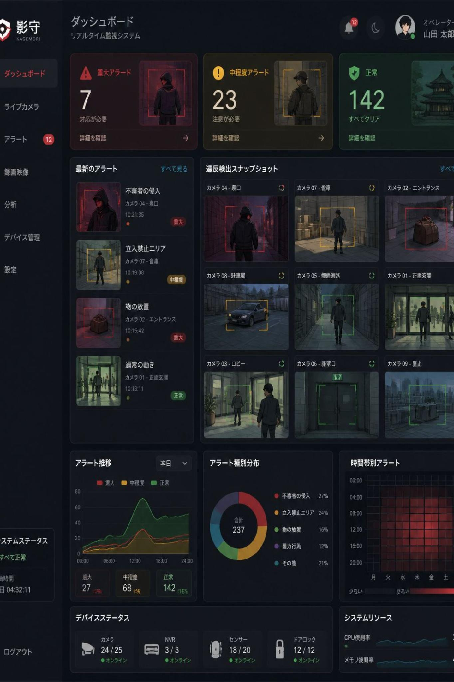
Your Command Center
The Zyvora dashboard gives you complete visibility across every branch — at a glance.
🔴 Alert Cards
📸 Violation Grid
Live status per branch — red, amber, or green at a glance.
Photo evidence organized by date, severity, and type.
📊 Reports Tab
Charts and trend data to track compliance over time.

Slide 8


CUSTOMER TRUST
Live View — Transparency Built In
Franchise customers can watch live order processing from any branch directly inside your mobile app — building trust and brand confidence.
Powered by a secure API with per-branch access keys, ensuring full control over who sees what.
Differentiator: No competing system offers a customer-facing live view.

Slide 9
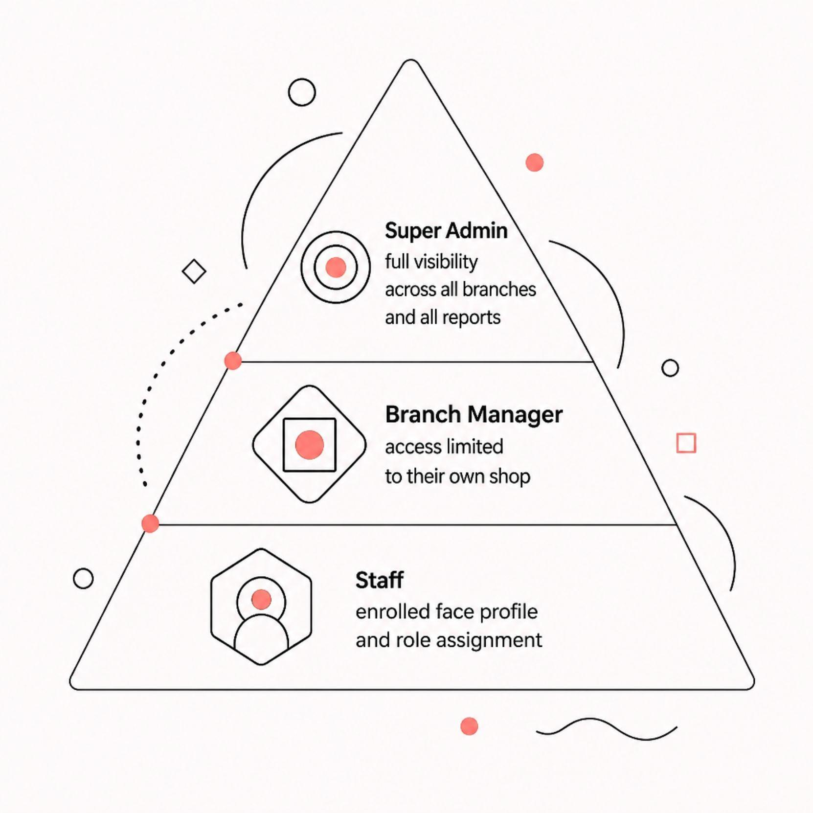

Employee & Branch Management
Employee Enrollment
Multi-Branch Control
Register staff with face photos. The system automatically names violating employees in reports. Roles include guard, cashier, butcher, manager, and more. Changes take effect instantly — no restart required.
Manage unlimited branches from one login. Super admin sees all; branch managers see only their shop. Set per-branch WhatsApp alert recipients and rank branches by violation count.

Slide 10




Why Choose Zyvora
Works With Your Cameras
On-Site, Not Cloud
Compatible with Dahua, Hikvision, Tapo, and IP Webcam — no replacement needed.
Your data stays with you. No cloud dependency, no third-party risk.
Sub-5-Second Alerts
Scales With You
Real-time notifications delivered faster than any manual process.
From 1 branch to 100+. Custom violation types per sector.
Ready to Take Control?
Contact Eonovate for a live demo. Innovating Tomorrow's Solutions Today.
sales@eonovate.com

